Slide 1
KYRGYZ BETWEEN THE MAIN POWERS OF CENTRAL ASIA
Cholpon CHOTAEVA
Anthropology, AUCA

Slide 2
Contents
Jungars
China
Koqand Khanate

Slide 3
Jungars
Name: Oirats, Kalmaks, Jungars
Origin: Mongolian speaking, left wing of Mongols (Jungar – “left hand”)
Territory: Northwestern Mongolia, Sinkiang

Slide 4
Jungar Khanate (XVII-XVIII)
Jungar – “left hand”
Tribes: Choro, Dorbot, Toghut, Koshot
Founder: Khara Khula (Choro)
Territory: Jungaria (Sinkiang in China)
Conquests: Mongolia, China, Central Asia

Slide 5
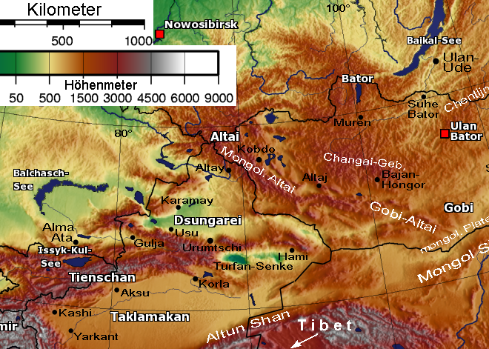
Map of Jungaria

Slide 6
Conquests of Central Asia
15 century
16 century
17-18 centuries
1643, 1652, 1658, 1681-3, 1727, 1748-9 – battles between Kyrgyzs and Kalmaks

Slide 7
Decline
1757-8 – Jungar Khanate was crashed by Qing (Manchu) dynasty in China
Jungar people were exterminated (70%)
Kalmyks – a people in Russia
Sart kalmak - a tribe of the Kyrgyzs

Slide 8
China
Sinkiang – “new region”
1758-9 – battles between Kyrgyzs and Chinese in the Issyk-Kul Valley
1758 – Kyrgyzs sent their embassy to China requesting to return their lands

Slide 9
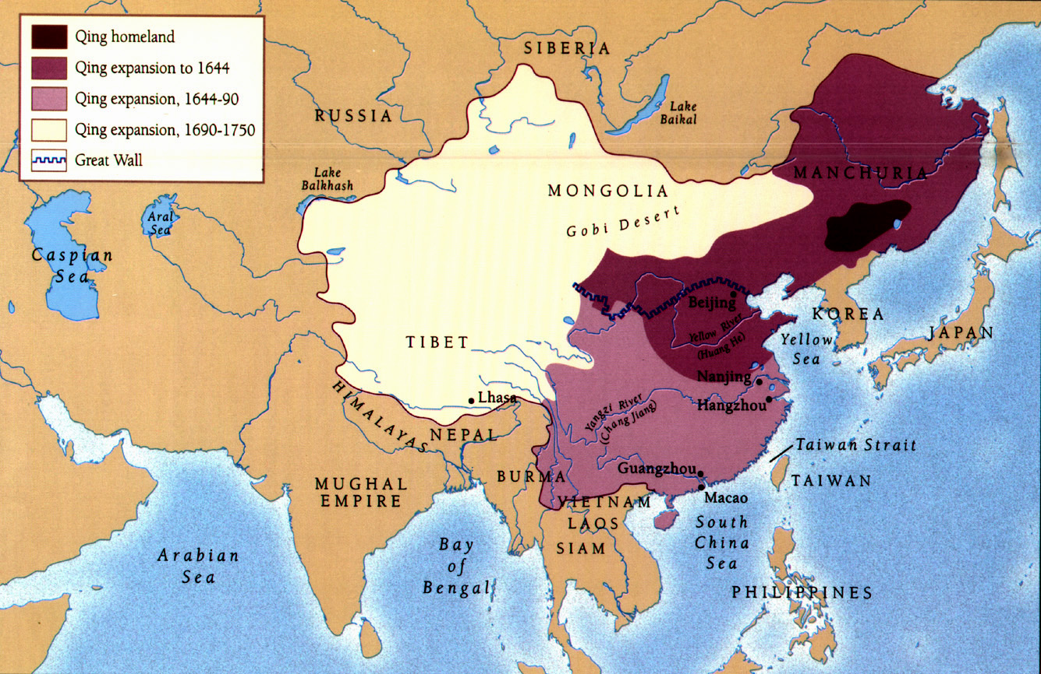

Slide 10
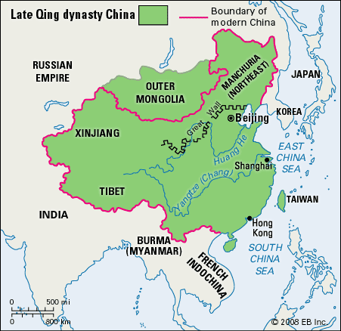

Slide 11
Koqand Khanate (XVIII-XIX)
Year founded: 1709-10
Founder: Shahrukh Biy (Ming Dynasty)
Origin: Shaybanids (Uzbeks), Timurids
Capital: Koqand city
Territory: the Fergana Valley,
from Semirechye to Pamir

Slide 12
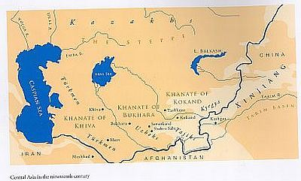

Slide 13
History of Koqand
Growth (1709-1800): Irdana Biy (bek)
Prosperity (1800-1840): Madali Khan
Decline (1840-1876): Khudayar Khan

Slide 14
Koqand Khanate and Kyrgyzs
Conquests:
Southern Kyrgyzstan (by 1820s)
Northern Kyrgyzstan (after 1820s): Tokmak, Kara Balta, At Bashi, Kochkor, Karakol, Barskon, Bishkek (1825), etc fortresses built

Slide 15
Economy
Land ownership:
Ashlaq – state ownership
Mulq – private ownership
Waqf – religious ownership
Taxes:
Zeket – tax on livestock
Tunduk zeket – tax on a yurt (one sheep)
Kharaj – tax on land (1/10 of harvest)
Military tax (3 sheep or 1 golden coin)

Slide 16
Rebellion of 1873-6
Leaders: Pulat Khan (Iskhak Hasan uulu),
Mamyr Mergen, Mamyrbai
Leader of Koqand army: Abdyrakhman Abtabachi
Reasons: Tax policy (pretext)
Political instability
Territory: the Fergana Valley
Composition: Kyrgyzs, Kypchaks, Uzbeks, Tajiks

Slide 17
Rebellion of 1873-6
Two stages:
1873-1874: Alai, Aksy (Pulat Khan), Aksy interfluve (Mamyr Mergen), Leilek (Mamyrbai)
1875-1876 – Abdyrakhman Abtabachi joined rebels, Russians suppressed the rebellion
Result: annexation and abolition of Koqand Khanate
Character: popular, anti-Koqand, anti-Russian, anti-colonial, national-liberation

Slide 18
Culture
Architecture: palaces, mosques, madrases
Art
Literature and poetry: Nadira

Slide 19
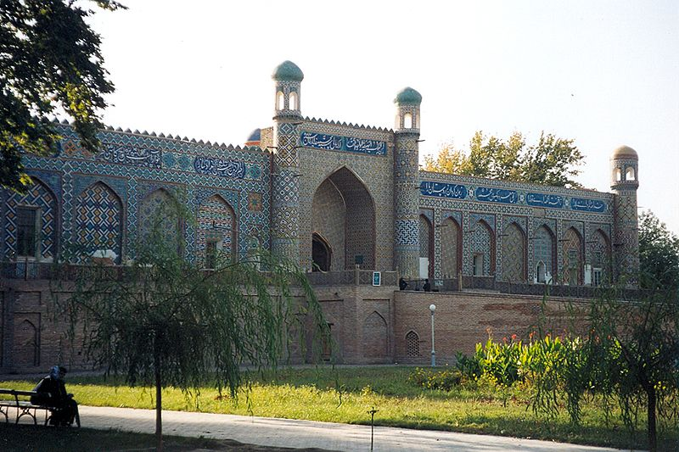
Palace of Khudayar Khan

Slide 20
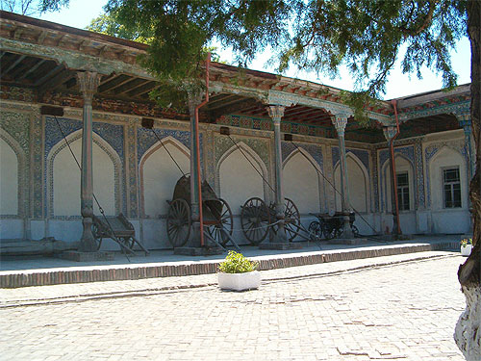
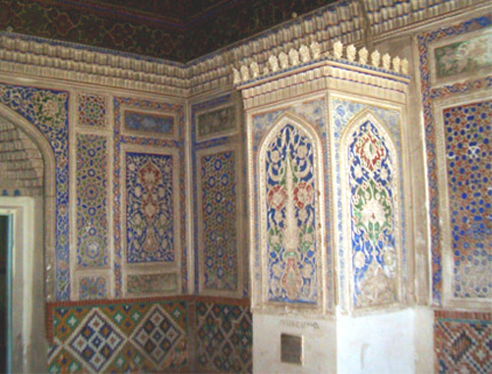

Slide 21
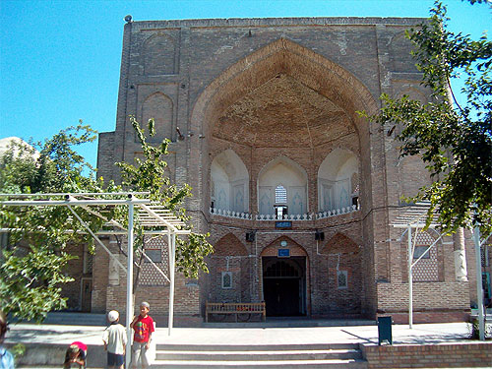
Dahman-Shakhon complex

Slide 22
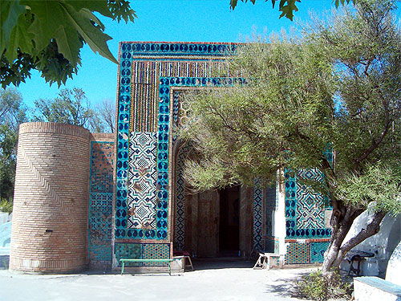
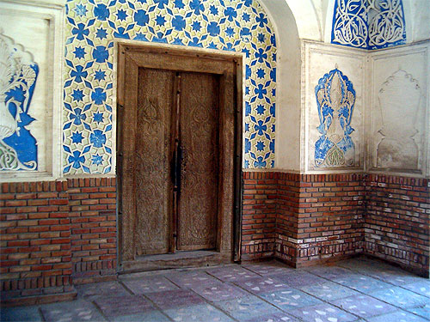
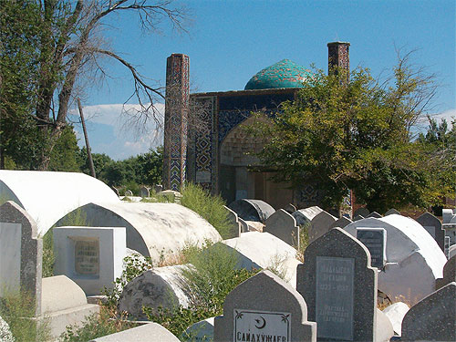
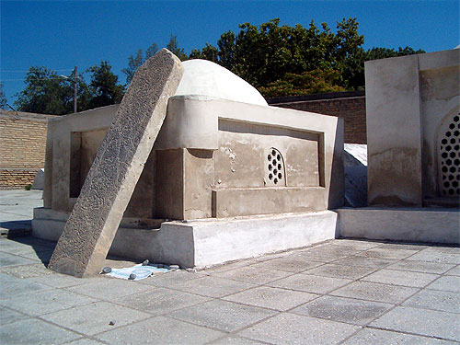

Slide 23
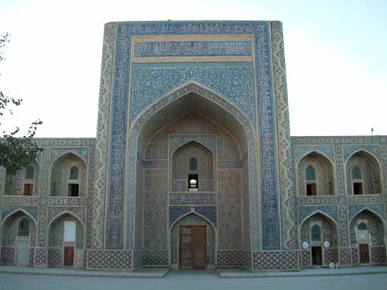
Modari-khan Madrasah

Slide 24
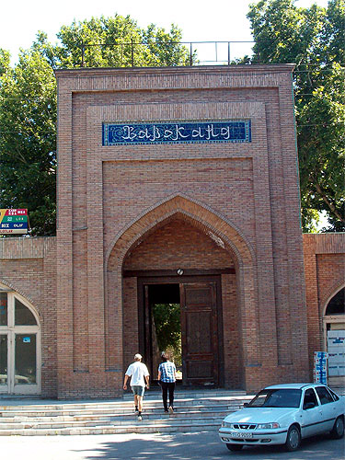
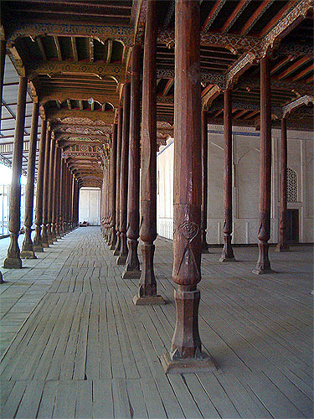
Djami Mosque and Minaret

Slide 25
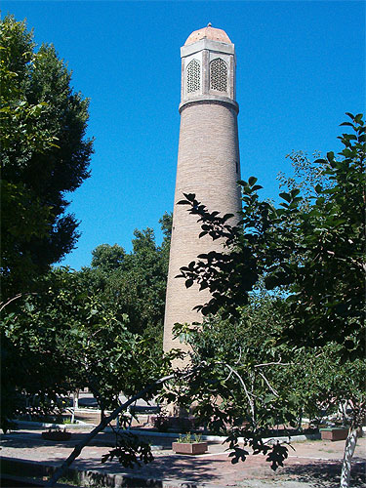
Minaret

Slide 26
Readings
Anthony Jenkinson’s Explorations on the Land Route to China, 1558-1560

